Slide 1
Course Name: Database Systems Course Code: CS52 Credits: 3:1:0 UNIT 5 Term: October 2021 – February 2022
M.S. Ramaiah Institute of Technology
(Autonomous Institute, Affiliated to VTU)
Department of Computer Science and Engineering
Faculty:
Dr. Sini Anna Alex

Slide 2
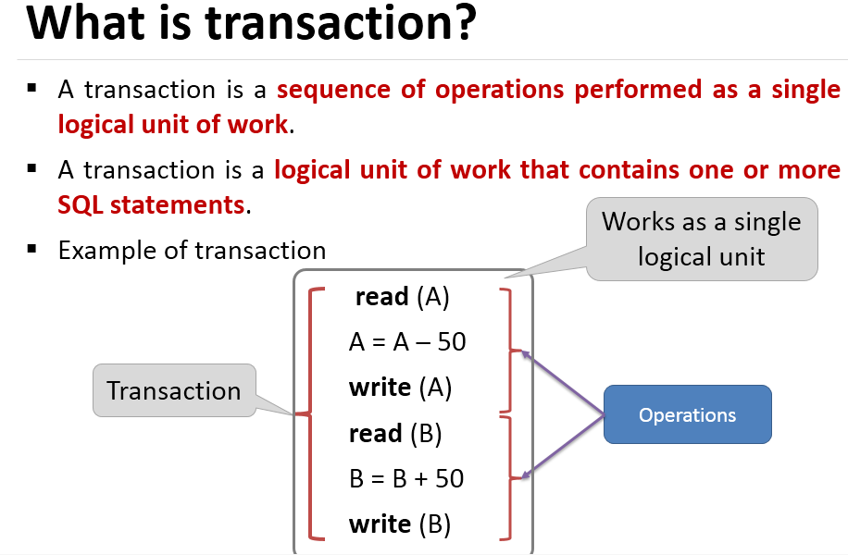

Slide 3
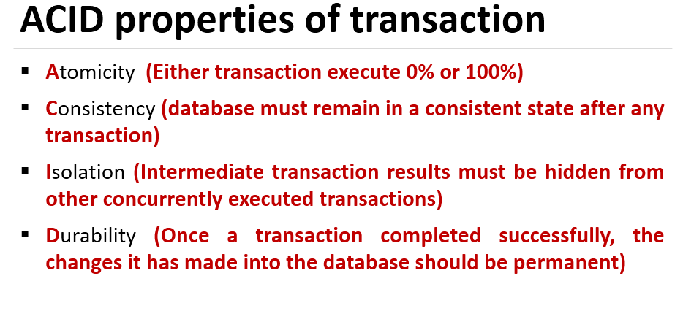

Slide 4
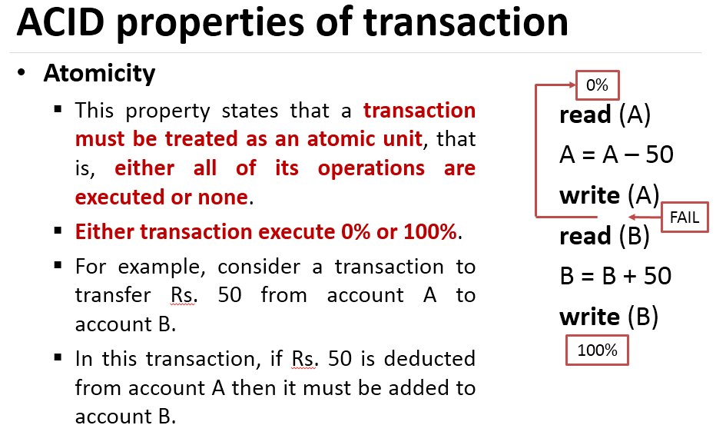

Slide 5
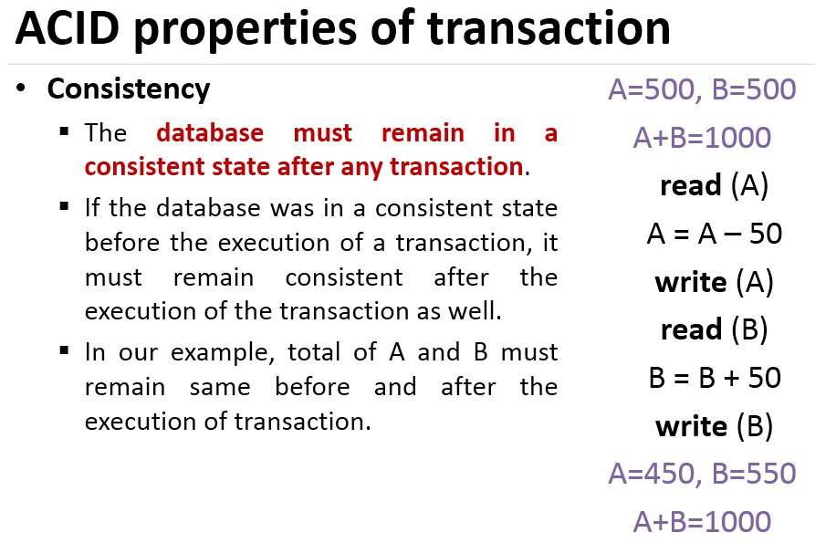

Slide 6
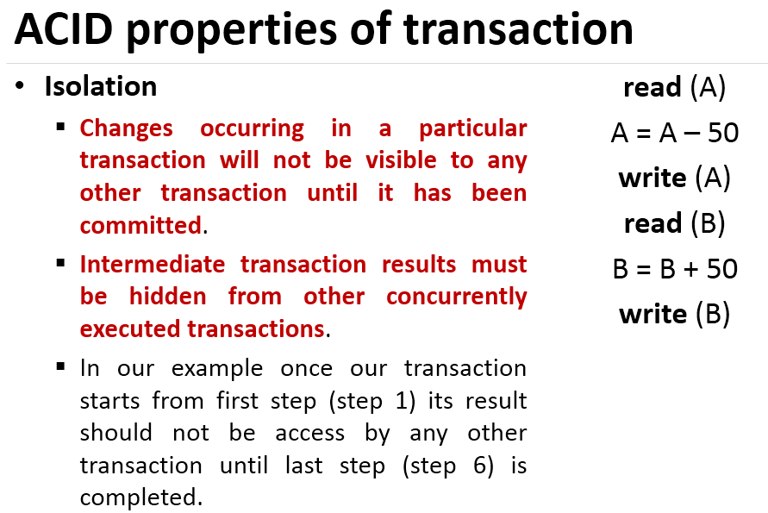

Slide 7
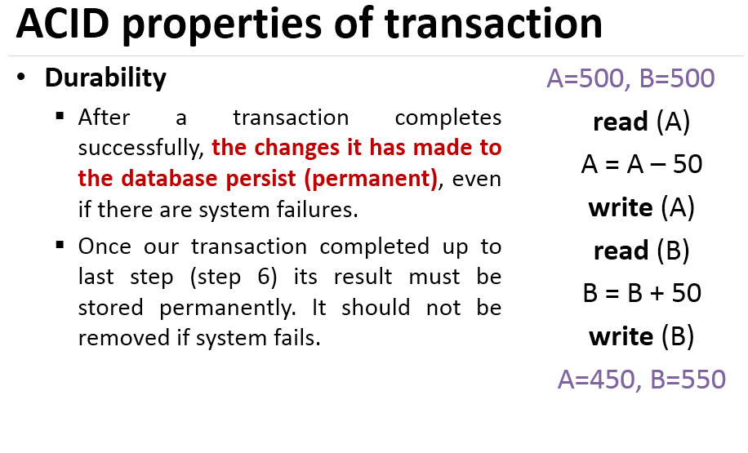

Slide 8
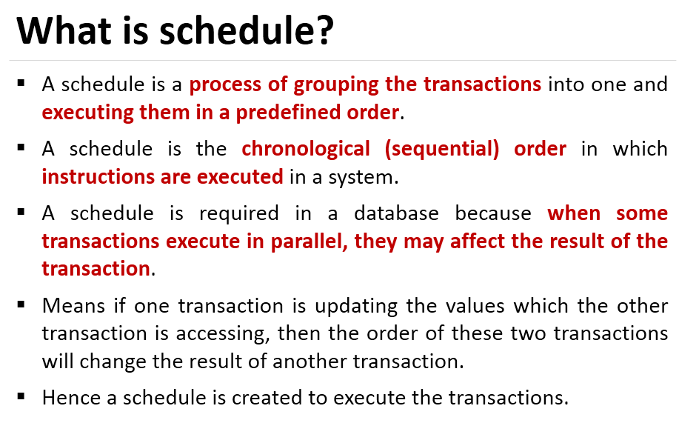

Slide 9
Characterizing Schedules based on Recoverability
Schedules classified on recoverability:
Recoverable schedule:
One where no transaction needs to be rolled back.
A schedule S is recoverable if no transaction T in S commits until all transactions T’ that have written an item that T reads have committed.
Cascadeless schedule:
One where every transaction reads only the items that are written by committed transactions.

Slide 10
Characterizing Schedules based on Recoverability
Schedules classified on recoverability (contd.):
Schedules requiring cascaded rollback:
A schedule in which uncommitted transactions that read an item from a failed transaction must be rolled back.
Strict Schedules:
A schedule in which a transaction can neither read or write an item X until the last transaction that wrote X has committed.

Slide 11
Characterizing Schedules Based on Recoverability
A shorthand notation for describing a schedule uses the symbols b, r, w, e, c, and a for the operations
begin_transaction, read_item, write_item, end_transaction, commit, and abort, respectively.
S_{a}: r₁(X); r₂(X); w₁(X); r₁(Y); w₂(X); w₁(Y);
Same as S_{a} except 2 commit operations
S_{b}: r₁(X); r₂(X); w₁(X); r₁(Y); w₂(X);c₂; w₁(Y);c₁
S_{b} is recoverable , even though it suffers from lost update problem
S_{c}: r₁(X); w₁(X); r₂(X); r₁(Y); w₂(X); c₂ ;a₁;
Is not recoverable because T2 reads item X from T1, and the T2 commits before T1 commits.

Slide 12
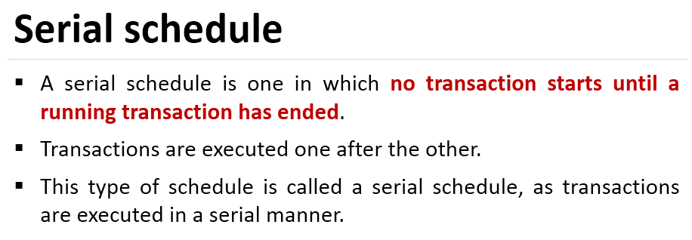

Slide 13
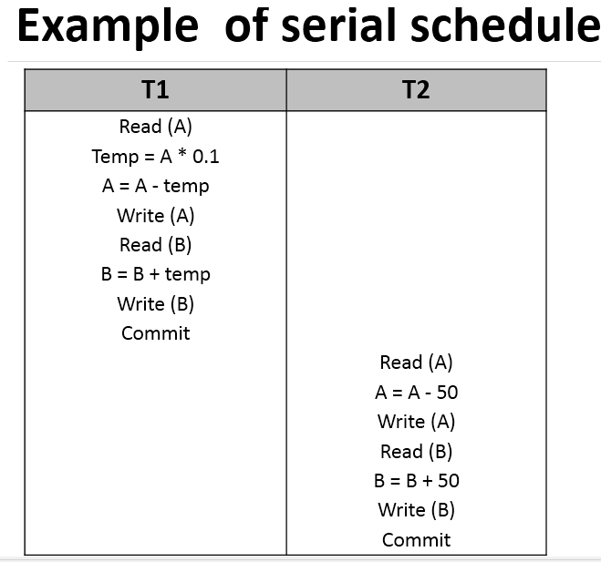

Slide 14
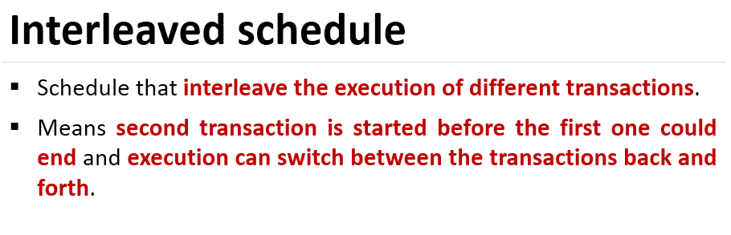

Slide 15
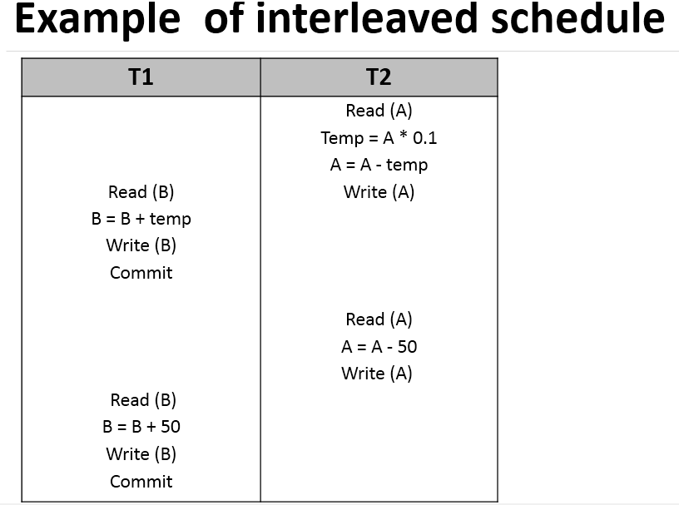

Slide 16
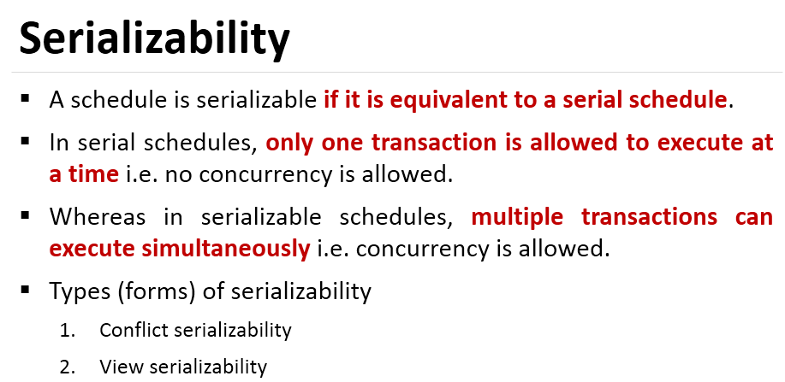

Slide 17
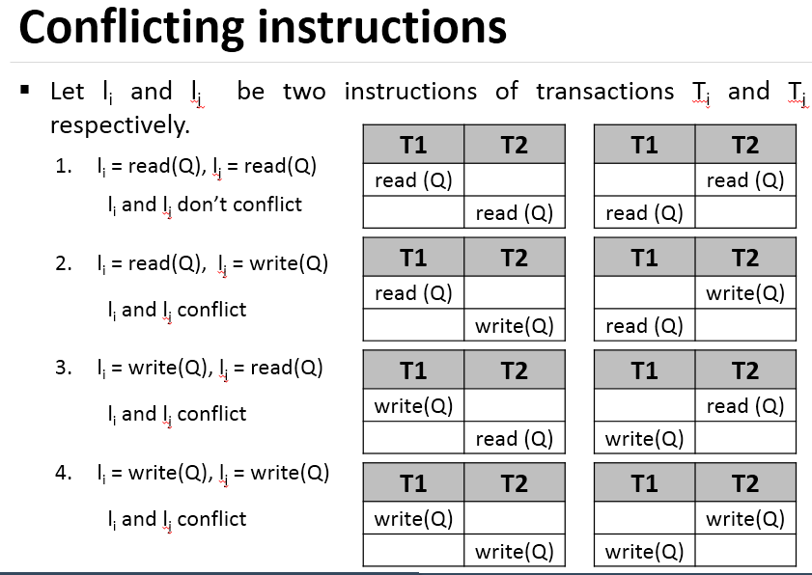

Slide 18
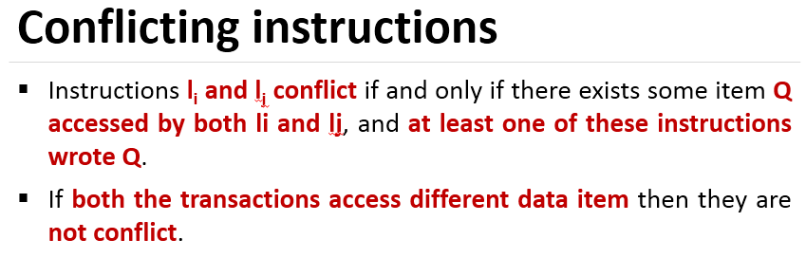
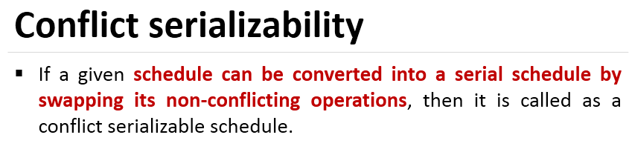

Slide 19
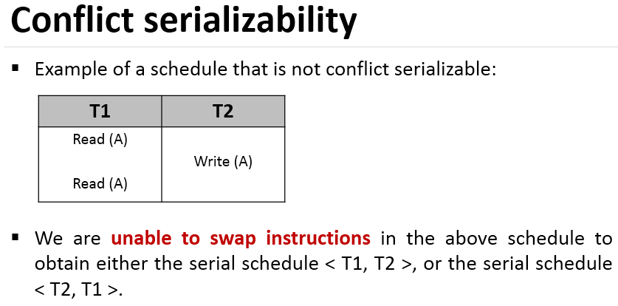

Slide 20
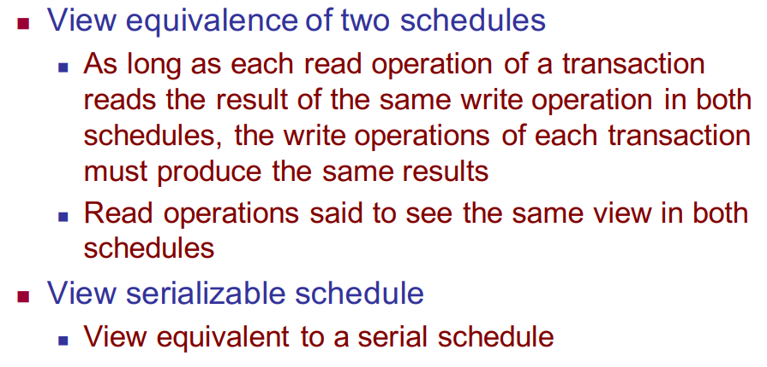
View Serializability

Slide 21
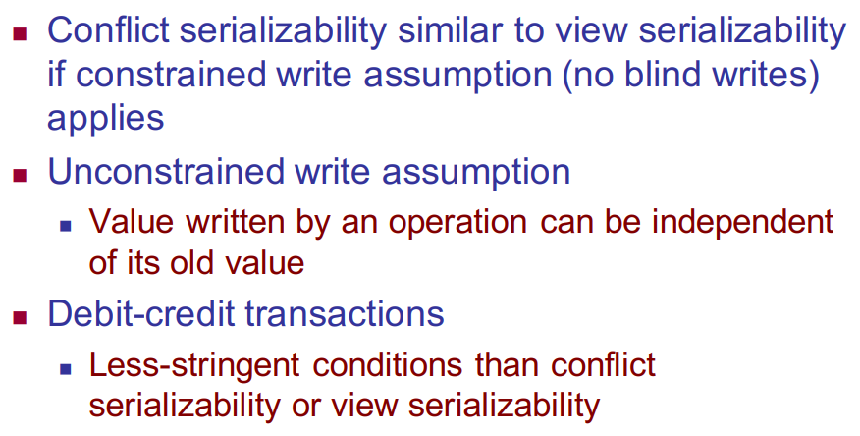

View Serializability

Slide 22
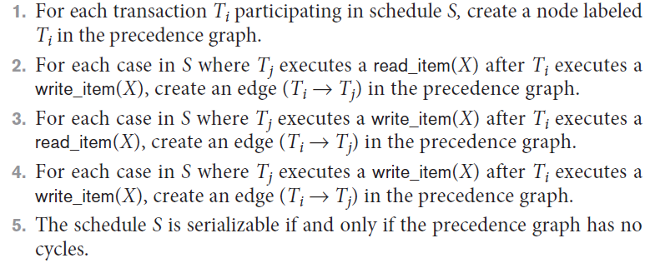
Characterizing Schedules Based on Serializability (cont’d.)
Testing for serializability of a schedule

Slide 23
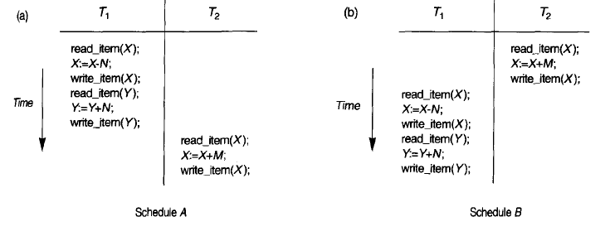
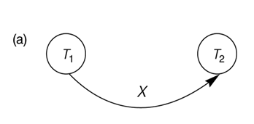
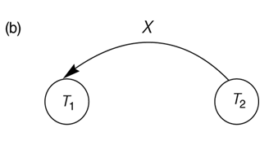
Constructing the Precedence Graphs
Constructing the precedence graphs for schedules A and D to test for conflict serializability.
(a) Precedence graph for serial schedule A.
(b) Precedence graph for serial schedule B.

Slide 24
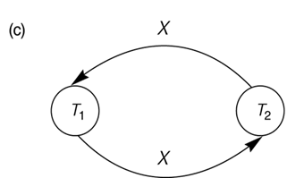
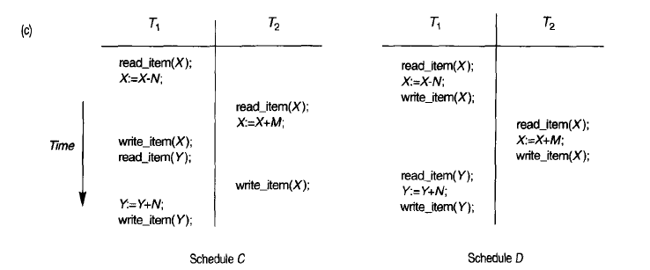
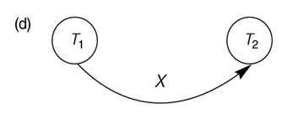
Constructing the precedence graphs for schedules A and D to test for conflict serializability.
(c) Precedence graph for schedule C (not serializable).
(d) Precedence graph for schedule D (serializable, equivalent to schedule A).

Slide 25
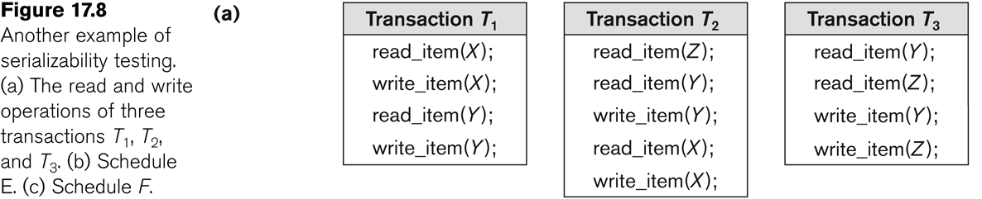
Another example of serializability Testing

Slide 26
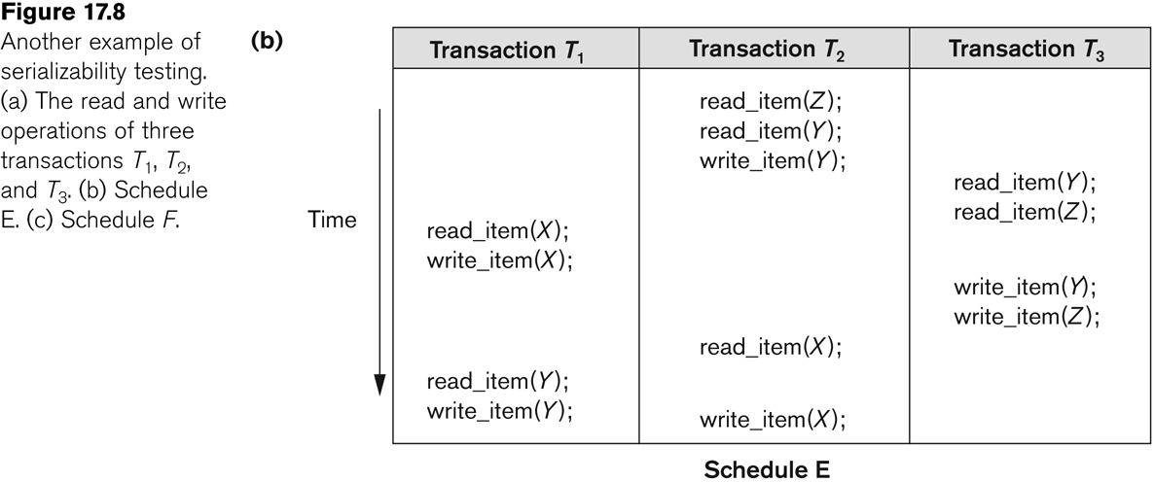
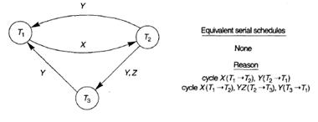
Another Example of Serializability Testing

Slide 27
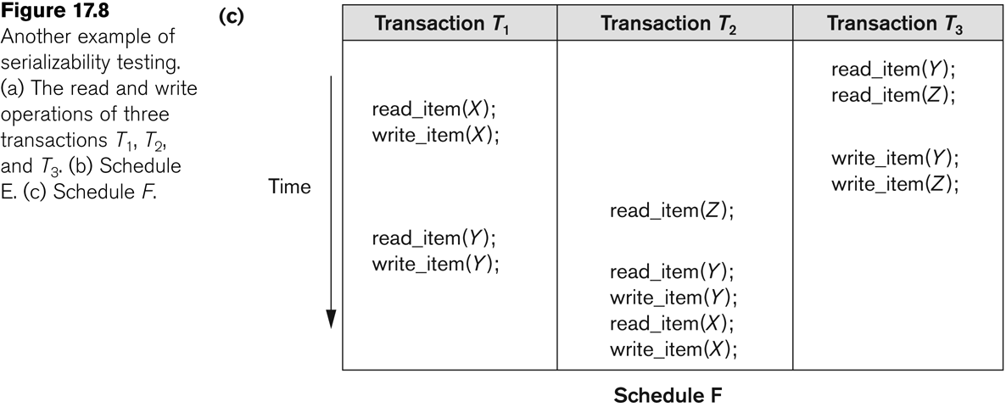
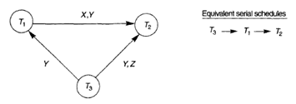
Another Example of Serializability Testing

Slide 28
Isolation levels in Transaction Processing
A transaction isolation level is defined by the following phenomena –
Dirty Read – A Dirty read is the situation when a transaction reads a data that has not yet been committed. Reading a value that was written by a transaction which failed.
S_{b}: r₁(X); w₁(X); r₂(X); r₁(Y); w₂(X);c₂; w₁(Y);c₁
Non Repeatable read – Non Repeatable read occurs when a transaction reads same row twice, and get a different value each time. Allowing another transaction to write a new value between multiple reads of one transaction.
A transaction T1 may read a given value from a table. If another transaction T2 later updates that value and T1 reads that value again, T1 will see a different value.
Phantom Read – Phantom Read occurs when two same queries are executed, but the rows retrieved by the two, are different.
Based on these phenomena, The SQL standard defines four isolation levels :

Slide 29
Isolation levels in Transaction Processing
Read Uncommitted – Read Uncommitted is the lowest isolation level. In this level, one transaction may read not yet committed changes made by other transaction, thereby allowing dirty reads. In this level, transactions are not isolated from each other.
Read Committed – This isolation level guarantees that any data read is committed at the moment it is read. Thus it does not allows dirty read. The transaction holds a read or write lock on the current row, and thus prevent other transactions from reading, updating or deleting it.

Slide 30
Isolation levels in Transaction Processing
Repeatable Read – This is the most restrictive isolation level. The transaction holds read locks on all rows it references and writes locks on all rows it inserts, updates, or deletes. Since other transaction cannot read, update or delete these rows, consequently it avoids non-repeatable read.
Serializable – This is the Highest isolation level. A serializable execution is guaranteed to be serializable. Serializable execution is defined to be an execution of operations in which concurrently executing transactions appears to be serially executing.

Slide 31
Transaction Support in SQL
Possible violation of serializabilty:
Type of Violation
Isolation Dirty nonrepeatable
level read read phantom
_______________________________________________________
READ UNCOMMITTED yes yes yes
READ COMMITTED no yes yes
REPEATABLE READ no no yes
SERIALIZABLE no no no

Slide 32
Which of the following Schedules is conflict serializable? For each serializable schedule , determine equivalent serial schedules
a). r1(X); r3(X); w1(X); r2(X); w3(X);
b). r1(X); r3(X); w3(X); w1(X); r2(X);
c). r3(X); r2(X); w3(X); r1(X); w1(X);
d). r3(X); r2(X); r1(X); w3(X); w1(X);

Slide 33
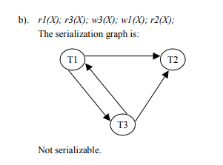
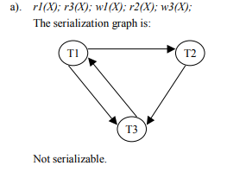
Solution
X
X
X
X
X
X
X
X

Slide 34
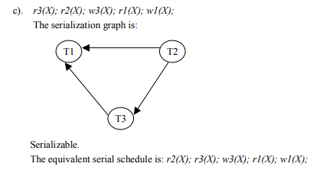
Solution
X
X
X

Slide 35

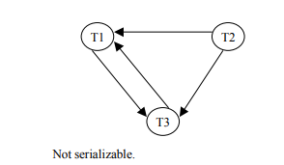
Solution
X
X
X
X

Slide 36
Thank you

